Slide 1

JF
OXO Connect 3.1 - Sales Companion
Edition 04a – March 2019

Slide 2
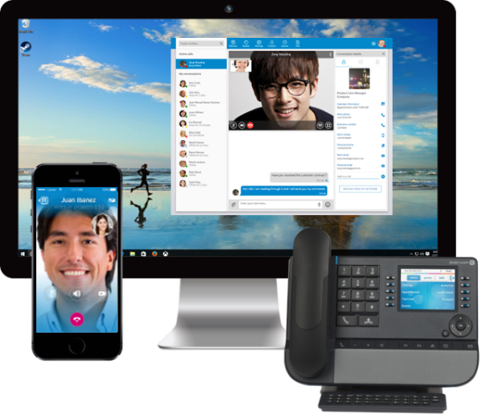
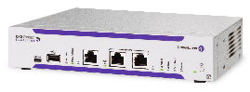
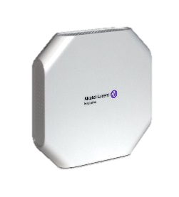
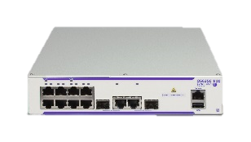




OXO Connect: Customer-focused Experience
Collaboration
Mobility
IP phones
Secure collaboration Intuitive group chat, sharing, mobile video, conferencing with teams, customers and business contacts
Digital phones
Other phones
DECT handsets
Rapid business response Intuitive Phones and apps for resident and mobile workers
WLAN handsets
Greeting
Routing
24/7 Virtual Front Door Built-in voice messaging and automated attendant Intuitive call management for all
DECT/IP DECT
WLAN
LAN
High-performance LAN, WLAN and IP DECT One network for voice and data Mobile workplace
Hospitality
Platform,
Services
Brochure
Datasheet
Video
Web site

Slide 3

Rainbow Essential Mobile video and file exchange for all. Click to call with business phone
Collaboration
Mobility
IP phones
What our customers like
Secure: no ads, no commercialized data, local datacenters
Video and file sharing everywhere
Integration with phone-system: See if office workers are on the phone
Benefits
Enterprise-grade solution: secure and IT-controlled
Mobility: exchange files and tap to video from everywhere
Collaboration: open to all employees and guests (for free) and shows telephony presence status
Options
Rainbow Business: One-number mobility and remote work
Rainbow Enterprise: Virtual meetings
Rainbow Enterprise Conference: any phone conferencing
Digital phones
Other phones
DECT handsets
WLAN handsets
Greeting
Routing
DECT/IP DECT
Short description Rainbow Essential is a FREE Cloud app to text, call, video and share instantly with your business community. Easily chat and share files, up to 20 participants per group. Instantly make audio or video calls and share your screen with just a click. Rainbow is connected to the Communication Server: Search the corporate directory, see employees’ on the phone presence and click to call with an ALE desk phone. Enterprise-grade control: the solution is secure and managed by IT through a web-based portal
WLAN
LAN
Hospitality
Mobile video and chat for all
Secure and hosted in privacy-conscious datacenters
Click to call and on-the-phone presence… for free
Platform,
Services

Slide 4
Rainbow Business Nomadic and one-number service for mobile and home workers
Collaboration
Mobility
IP phones
What our customers like
Nomadic settings from Rainbow: select any phone to receive or place calls with your business line id
Mobility: one number service across phone, smartphone, computer (*)
Secure, firewall friendly WebRTC technology
Benefits
Business image: Take and place calls from your business line wherever you are
Mobility: Handle business calls on smartphone or computer
Better work/private life balance: work from home
Options
(*) WebRTC Gateway: business calls between OXO Connect and Rainbow apps
Digital phones
Other phones
DECT handsets
WLAN handsets
Greeting
Routing
DECT/IP DECT
Short description Control your business phone from within the Rainbow app: enquiry, hold, broker, three-way conference. No need for third-party CTI application (ESTOS, etc.). No client to install on PC: Rainbow is web-based. Nomadic: select in Rainbow on which OXO Connect phone or public number to place and receive calls. WebRTC Gateway: additional software/appliance to exchange WebRTC voice between OXO Connect and Rainbow apps; One number service across Rainbow and OXO Connect business phone. Skype For Business add-in.
WLAN
LAN
Hospitality
Select any phone to place and receive calls (nomadic)
One number service for mobile business calls (*)
Home worker solution (*)
Platform,
Services

Slide 5
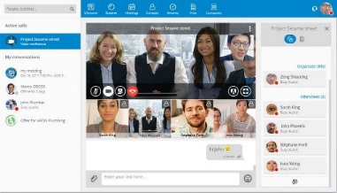
Rainbow Enterprise Video conferences and virtual meetings
Collaboration
Mobility
IP phones
What our customers like
Team collaboration groups up to 100 participants to chat and share files with team and external contacts
Instant meeting with voice, video, file/screen sharing up to 20 participants
Invite guests: they don’t need a Rainbow account
Benefits
Ease adoption by using a single app for team chat, phone control and conferences
Decrease costs: external conference bridges only for large meetings or for dial-in/dial-out from any phone
Options
Digital phones
Other phones
DECT handsets
WLAN handsets
Greeting
Routing
DECT/IP DECT
Short description All Essential and Business features. Team chat group up to 100 participants. 20 Gb stoage per user. Live audio/video/screen share meeting up to 20 participants (PC or smartphone required). See 5 video streams, select one for large display. Invite guests by email: they don’t need a Rainbow account. Add-in to call or chat from within Outlook. User provisioning with Microsoft Azure AD.
WLAN
LAN
Hospitality
Groups up to 100 participants
20 Gb file sharing per user
Instant video meetings up to 20 participants, with guests
Platform,
Services

Slide 6
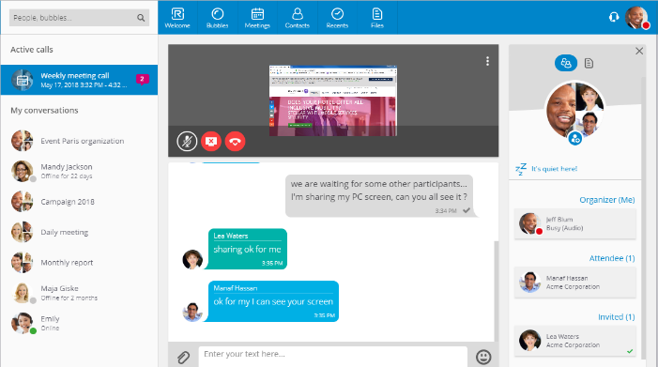
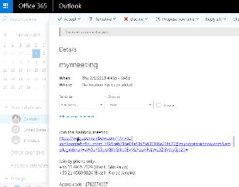
Rainbow Enterprise Conference Audio and web conferences. Dial-in from many countries
Collaboration
Mobility
IP phones
What our customers like
Invite guests from Outlook add-in
Share files and screen while meeting over the phone.
Local access points in many countries for better audio quality and affordable pricing
Benefits
Remote meetings with people outside the company
Simplicity: join from any phone and web app
Audio quality: local points of presence
Options
Rainbow Conference: Pay-as-you-go subscription charged on a per/minute, per/connection basis. Dial-out capabilities depending on country
Digital phones
Other phones
DECT handsets
WLAN handsets
Greeting
Routing
DECT/IP DECT
Short description All Essential, Business, Enterprise features. Provides scheduled or instant PSTN conferences created from within Rainbow, charged per user, per month. Up to 100 participants. Local points of presence for local dial-in capabilities depending on country. Conference owner shares screen and can delegate to participants. Dial-in in one click. Chat. File sharing. See who joins, who talks. Mute noisy lines. Outlook add-in.
WLAN
LAN
Hospitality
Web Conferencing open to guests
Join from any phone
Local points of presence: audio quality, affordable pricing
Platform,
Services

Slide 7
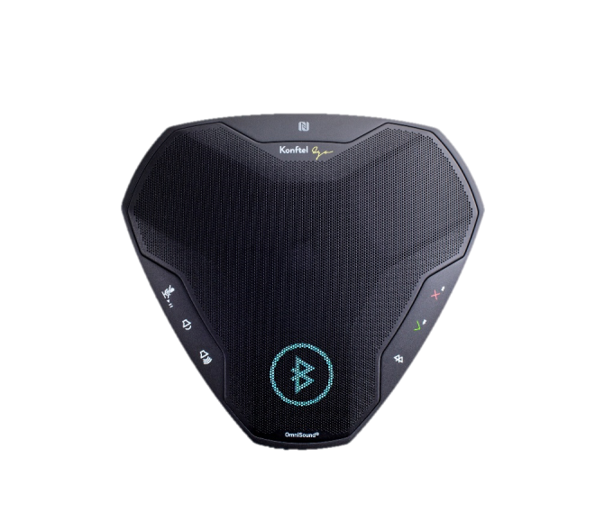

8105s EGO Portable conferencing module. Rainbow companion
Collaboration
Collaboration
Mobility
Mobility
IP phones
IP phones
What our customers like
Light and compact device: fits in a work bag
Battery supports 12 hours of call time
OmniSound audio with full duplex, automatic echo cancellation and noise suppression
Benefits
Ideal for the office, a small huddle room or at home.
Provides a full day operation without recharging
Enjoy enterprise-grade quality conversations
Digital phones
Digital phones
Other phones
Other phones
DECT handsets
DECT handsets
WLAN handsets
WLAN handsets
Greeting
Greeting
Routing
Routing
DECT/IP DECT
DECT/IP DECT
Short description The Alcatel-Lucent 8105s EGO is an enterprise-grade portable conference module that complements Alcatel-Lucent Rainbow for virtual meetings. Connect the 8105s EGO to a laptop through a USB or connect to a smartphone using Bluetooth and benefit from high-quality audio meetings wherever you are. Bluetooth 4.0, USB 2.0, 3.5mm port headset. Touch screen buttons Call, end call, in a tap; see if mute mode is active at a glance.
WLAN
WLAN
LAN
LAN
Hospitality
Hospitality
Light and compact
Rainbow smartphone/laptop companion
OmniSound audio
Platform,
Services
Platform,
Services

Slide 8
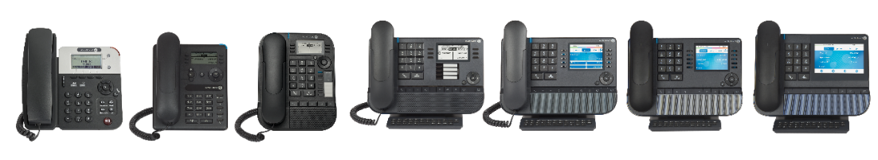
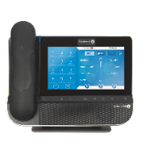
Collaboration
Mobility
IP phones
 | 8001G | 8008/8008G | 8018 | 8028s | 8058s | 8068s BT 8068s | 8078s BT 8078s | 8088v2 BT 8088 BT NoCam, 8088
Key highlights at a glance | SIP | Compact, Business features | Compact, Speed dial keys | Alphabetic Keyboard | 5-line color screen | Bluetooth Handset/ Headset | Touch screen | 100% Touch, Video, Android apps
Rainbow connected |  | ■ | ■ | ■ | ■ | ■ | ■ | ■
Capacitive touch screen |  |  |  |  |  |  | ■ (5”) | ■ (7”)
Bluetooth (headset, pairing with smartphone) |  |  |  |  |  | ■ | ■ | ■
Color screen |  |  |  |  | ■ | ■ | ■ | ■
Adjustable foot stand (20-60°) |  |  |  | ■ | ■ | ■ | ■ | ■
Mag. Alphabetic Keyboard |  |  |  | ■ | ■ | ■ | ■ | Touch
Speed-dial keys |  |  | 4 | 4 + key modules | + 10⁽¹⁾, 14 smart, 40 key modules |  |  | -
Contextual keys | 6 | 6 | 6 | 6 | 10 | 10 | Touch | Touch
eHD audio + eHD loudspeaker |  |  |  | ■ | ■ | ■ | ■ | ■
ALE business communications | SIP | ■ | ■ | ■ | ■ | ■ | ■ | ■
Headset: RJ9 / 3.5mm jack / USB | /-/ - | /-/ - | /-/ | -// | -// | -// | -// | -//
Wideband audio | ■ | ■ | ■ | ■ | ■ | ■ | ■ | ■
VPN client | ■ | ■ | ■ | ■ | ■ | ■ | ■ | ■
PC port | GE | FE/GE | GE | GE | GE | GE | GE | GE
Digital phones
Other phones
DECT handsets
WLAN handsets
Greeting
Routing
DECT/IP DECT
WLAN
LAN
Hospitality
Expert communications
Premium experience
Stylish design
Platform,
Services
(1) except 8078s

Slide 9
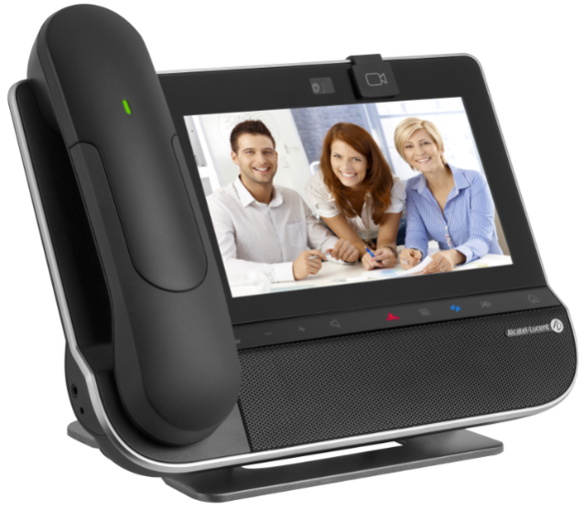
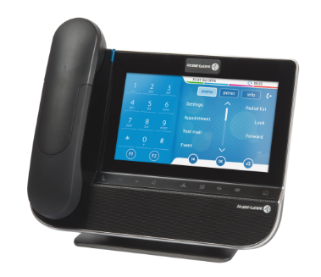
8088 BT Smart DeskPhone v2 Video touch phone for executives, front desk. Bluetooth handset
Collaboration
Collaboration
Mobility
Mobility
IP phones
IP phones
What our customers like
Sleek design and 100% touch experience
Android apps / web browser for business apps/customization or doorcam
Personal video (requires Rainbow or an Android video app)
Benefits
High-quality experience for executives and business owners
Cost effective videoconferencing equipment
High quality audio / video meetings between sites / teams
Options
3MG27112ND No-cam model
3MG27113AB Wired handset model
Digital phones
Digital phones
Other phones
Other phones
DECT handsets
DECT handsets
WLAN handsets
WLAN handsets
Greeting
Greeting
Routing
Routing
DECT/IP DECT
DECT/IP DECT
Short description
Makes collaboration between sites and teams easier. 7” touch screen, integrated camera and wideband audio for high-quality remote meetings. HDMI® output for screen duplication and USB input for external camera to transform any basic meeting room into a videoconferencing room. Supports a dedicated Rainbow app for video conversations with your Rainbow contacts. Supports Android apps for business customization. Also a cam-less model. ALE business communications.
WLAN
WLAN
LAN
LAN
Hospitality
Hospitality
Built-in camera
Rainbow video as easy as a phone call
Use as doorcam receiver
Platform,
Services
Platform,
Services

Slide 10
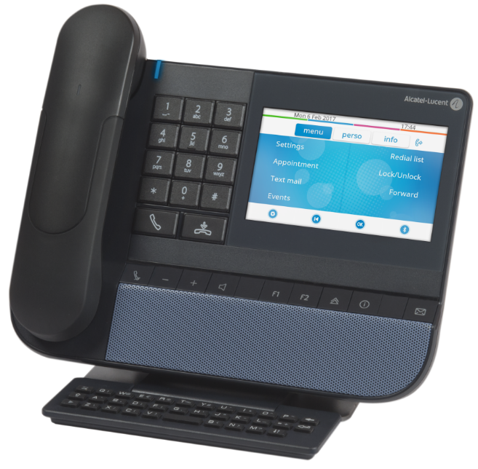
8078s BT Premium DeskPhone Touch screen phone for executives. Bluetooth handset
Collaboration
Collaboration
Mobility
Mobility
IP phones
IP phones
What our customers like
Combination of 5” touch screen and external keyboard
BT handset – keep talking up to 10 meters from desk
USB port for headset and to recharge smartphone
Benefits
Visual comfort: high quality large color touch-screen
Super fast touch navigation
Audio comfort: high-quality hands free and handset
Options
3GV2804xxx Wired headset
3GV28057xx USB headset
3MG27006xx Power adaptor
3MG27107AC Premium Smart display 14 keys module
3MG27106AC Premium 40 keys add-on module
Digital phones
Digital phones
Other phones
Other phones
DECT handsets
DECT handsets
WLAN handsets
WLAN handsets
Greeting
Greeting
Routing
Routing
DECT/IP DECT
DECT/IP DECT
WLAN
Short description Offers the richest experience together with a high level of comfort in use. Large color screen and intuitive user interface. Easy-to-use with function keys, interactive keys and alphabetic keyboard. Wideband audio. IP technology with integrated PC connection. VPN client. Also corded handset model. Low power consumption.
WLAN
LAN
LAN
Hospitality
Hospitality
Super fast, large touch-screen
External keyboard
Bluetooth handset
Platform,
Services
Platform,
Services

Slide 11
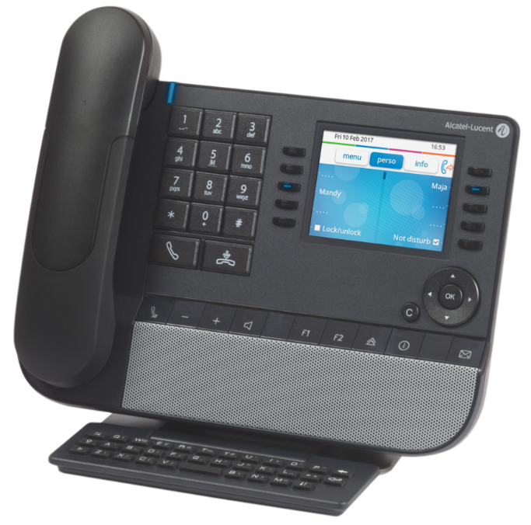
8068s BT Premium DeskPhone Large color screen phone for managers. Bluetooth handset
Collaboration
Collaboration
Mobility
Mobility
IP phones
IP phones
What our customers like
BT handset – keep talking up to 10 meters from desk
Ease of use with 10 contextual keys, large color backlit screen and integrated keyboard
USB port for headset and to recharge smartphone
Benefits
Visual comfort: high-quality color screen with contextual keys
Audio comfort: high-quality handsfree and handset
Easy directory lookup and ALE features/navigation
Options
3GV2804xxx Wired headset
3GV28057xx USB headset
3MG27006xx Power adaptor
3MG27105AC Premium 10 keys add-on module S
3MG27107AC Premium Smart display 14 keys module S
3MG27106AC Premium 40 keys add-on module S
Digital phones
Digital phones
Other phones
Other phones
DECT handsets
DECT handsets
WLAN handsets
WLAN handsets
Greeting
Greeting
Routing
Routing
DECT/IP DECT
DECT/IP DECT
WLAN
Short description Offers the richest communication experience with high level of comfort in use. Easy-to-use with function keys, interactive keys and alphabetic keyboard. Large backlit screen. Wideband audio. IP technology with integrated PC connection. VPN client. Low power consumption.
WLAN
LAN
LAN
Hospitality
Hospitality
Vivid color screen
Alphabetic keyboard
Bluetooth handset
Platform,
Services
Platform,
Services

Slide 12
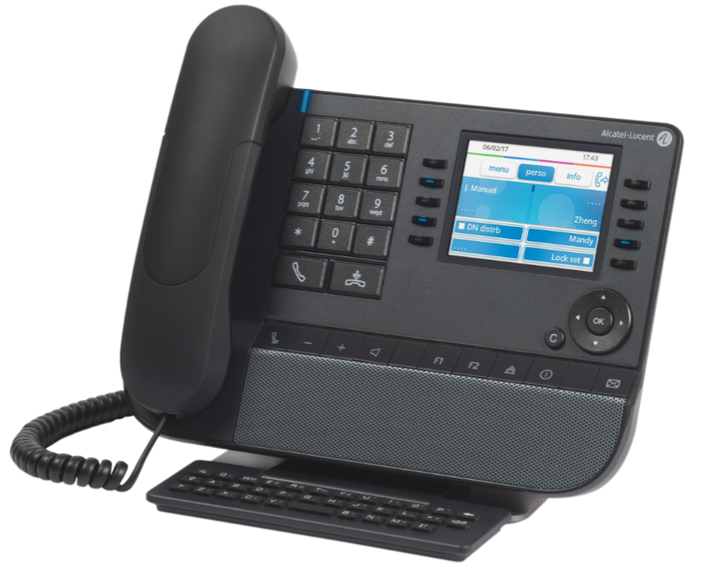
8058s Premium DeskPhone Large color screen phone for managers.
Collaboration
Collaboration
Mobility
Mobility
IP phones
IP phones
What our customers like
Wideband comfort handset and speakerphone
Ease of use with 10 contextual keys, large color screen and integrated alphabetic keyboard
USB port for headset and to recharge smartphone
Benefits
Visual comfort: high-quality color screen with contextual keys
Audio comfort: high-quality handsfree and handset
Easy directory lookup and ALE features/navigation
Options
3GV2804xxx Wired headset
3GV28057xx USB headset
3MG27006xx Power adaptor
3MG27105AC Premium 10 keys add-on module S
3MG27107AC Premium Smart display 14 keys module S
3MG27106AC Premium 40 keys add-on module S
Digital phones
Digital phones
Other phones
Other phones
DECT handsets
DECT handsets
WLAN handsets
WLAN handsets
Greeting
Greeting
Routing
Routing
DECT/IP DECT
DECT/IP DECT
WLAN
Short description Offers the richest communication experience with high level of comfort in use. Easy-to-use with function keys, interactive keys and alphabetic keyboard. Large color screen. Wideband audio. IP technology with integrated PC connection. VPN client. Low power consumption.
WLAN
LAN
LAN
Hospitality
Hospitality
Vivid color screen
Alphabetic keyboard
Wideband handset, speakerphone
Platform,
Services
Platform,
Services

Slide 13
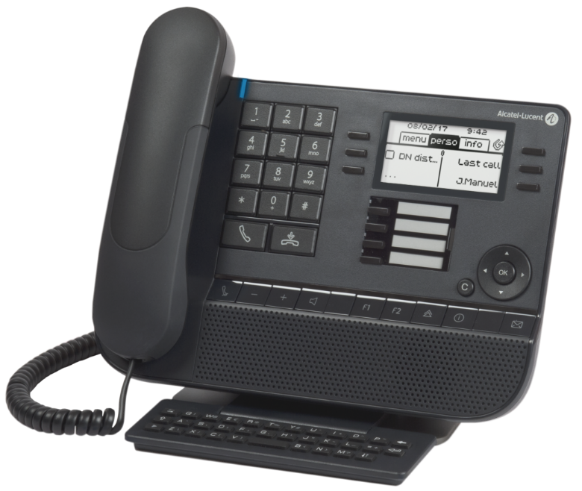
8028s Premium DeskPhone Premium phone for intensive usage.
Collaboration
Collaboration
Mobility
Mobility
IP phones
IP phones
What our customers like
Wideband comfort handset
Ease of use with 6 contextual keys, 4 labeled speed-dial keys, backlit screen and integrated keyboard
USB port for headset and to recharge smartphone
Benefits
Visual comfort: backlit multi-line display with contextual keys
Audio comfort: high-quality handsfree and handset
Easy directory lookup and ALE features/navigation
Options
3GV2804xxx Wired headset
3GV28057xx USB headset
3MG27006xx Power adaptor
3MG27105AC Premium 10 keys add-on module S
3MG27107AC Premium Smart display 14 keys module S
3MG27106AC Premium 40 keys add-on module S
Digital phones
Digital phones
Other phones
Other phones
DECT handsets
DECT handsets
WLAN handsets
WLAN handsets
Greeting
Greeting
Routing
Routing
DECT/IP DECT
DECT/IP DECT
WLAN
Short description Offers a rich communication experience with a high level of comfort in use. Easy-to-use with function keys, contextual keys and alphabetic keyboard. Backlit screen. Wideband audio. IP technology with integrated PC connection. VPN client. Low power consumption.
WLAN
LAN
LAN
Hospitality
Hospitality
White backlit screen
Alphabetic keyboard
4 speed-dial keys
Platform,
Services
Platform,
Services

Slide 14
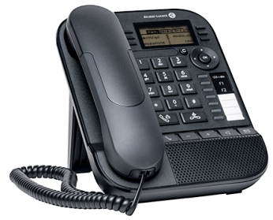
8018 DeskPhone Compact phone for intensive usage. Gigabit Ethernet PC port.
Collaboration
Mobility
IP phones
What our customers like
Compact model
Ease of use with 6 contextual keys, 4 labeled speed-dial keys, backlit screen and compact design
USB port for headset and to recharge smartphone
Benefits
Visual comfort: backlit multi-line display with contextual keys
Audio comfort: high-quality handsfree and handset
Customer-focus: ALE features/navigation
Options
• 3MG27210AA: Wall mounting kit
• 3MG27006xx: Power supply x4
• 3GV28057xx: Binaural USB-jack 3,5mm Headset
• Spare parts: Customizable clip, paper label covers
Digital phones
Other phones
DECT handsets
WLAN handsets
Greeting
Routing
DECT/IP DECT
WLAN
Short description Offers the richest communication experience with high level of comfort in use. Easy-to-use with function keys, interactive keys. White backlit screen. Wideband audio. IP technology with integrated PC connection. VPN client. Low power consumption.
LAN
Hospitality
White backlit screen
Compact model
USB headset port
Platform,
Services

Slide 15
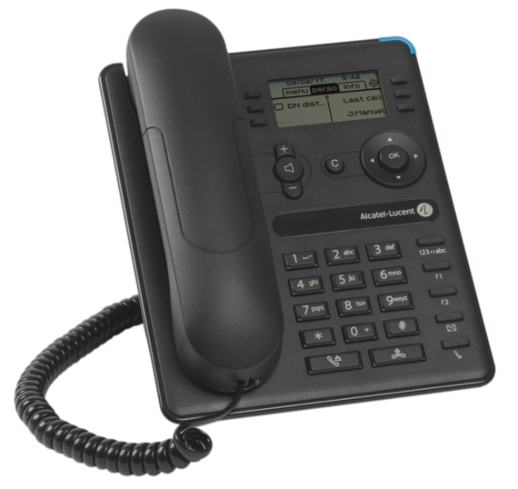
8008/8008G DeskPhone Compact essential phone. ALE features
Collaboration
Mobility
IP phones
What our customers like
Expert ALE Business communications
3-line screen with contextual keys for visual guidance
Compact model with “Premium” design
Benefits
Expert business communications with visual and vocal guidance for excellent ease of use
Audio comfort: wideband audio ready
Cost-effective, compact model with low power consumption
Options
3MG08021AA 8008 DeskPhone model: Fast Ethernet PC-through port, no backlit screen
3MG08011AA External power adapter
3MG08012AA Wideband handset
3MG08013AA Wall mounting kit
3MG08014AA Plastic foot (x10)
Digital phones
Other phones
DECT handsets
WLAN handsets
Greeting
Routing
DECT/IP DECT
WLAN
Short description Offers the richest communication experience with high level of comfort in use. Easy-to-use with function keys, interactive keys. Easy dial-by-name toggle key. Backlit screen (8008G). Wideband audio. IP technology with integrated Gigabit Ethernet (8008G) or Fast-Ethernet PC connection (8008). VPN client for use in small and home offices. Low power consumption.
LAN
Hospitality
ALE features, navigation
Compact model
Wideband handset
Platform,
Services

Slide 16
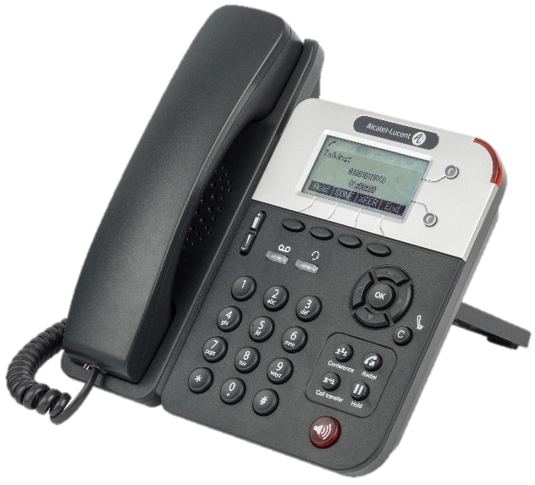
8001G DeskPhone Essential enterprise-grade SIP phone.
Collaboration
Mobility
IP phones
What our customers like
Save on POE ports with built-in Gigabit Ethernet PC port
Compact model with large screen
Easy to use redial, hold, transfer, conference application keys
Benefits
Entry-level phones with large screen at attractive price
Built-in 3-way conference
Central management: cost-effective vs 3rd-party SIP phone
Options
Digital phones
Other phones
DECT handsets
WLAN handsets
Greeting
Routing
DECT/IP DECT
WLAN
Short description Cost effective entry-level phone for basic communications requirements. Centrally managed. Integrated Gigabit Ethernet PC connection. Low power consumption. SIP technology.
LAN
Hospitality
Gigabit Ethernet PC-through @ Attractive price
Easy navigation: large screen, application keys
Centrally managed SIP phone
Platform,
Services

Slide 17
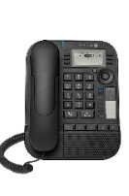
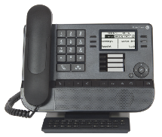
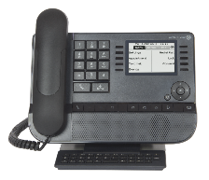
Collaboration
Mobility
IP phones
Digital phones
 | 8019s | 8029s | 8039s
Key highlights at a glance | Compact model | Alphabetic Keyboard | Large backlit screen
Rainbow connected | ■ | ■ | ■
White backlight screen | ■ | ■ | ■
Mag. Alphabetic Keyboard |  | ■ | ■
Jack 4-pole port (headset) | ■ | ■ | ■
Adjustable foot stand (20-60°) |  | ■ | ■
ALE communication features: contextual keys | 6 | 6 | 10
Speed-dial keys | 4 | 4 + 10, 20, 40 key add-on modules | + 10, 20, 40 key add-on modules
Digital 2-wire connectivity | ■ | ■ | ■
Other phones
DECT handsets
WLAN handsets
Greeting
Routing
DECT/IP DECT
WLAN
LAN
Hospitality
Cost-effective connectivity
ALE Business Communications
Stylish design
Platform,
Services

Slide 18
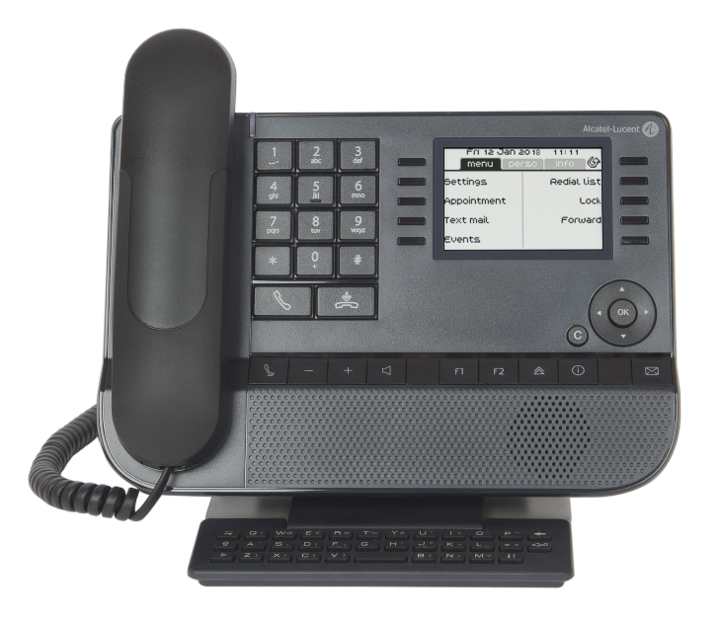
8039s Premium DeskPhone Large screen phone for managers. Digital.
Collaboration
Mobility
IP phones
What our customers like
Comfort handset
Ease of use with 10 contextual keys, large backlit screen and integrated alphabetic keyboard
Digital connectivity: no IP/POE, power supply requirement
Benefits
Visual comfort: multi-line display with contextual keys
Easy directory lookup and ALE features/navigation
Cost-effective digital connectivity
Options
3MG27105AC Premium 10 keys add-on module S
3MG27107AC Premium Smart display 14 keys module S
3MG27106AC Premium 40 keys add-on module S
Digital phones
Other phones
DECT handsets
WLAN handsets
Greeting
Routing
DECT/IP DECT
WLAN
Short description Offers the richest communication experience with high level of comfort in use. Easy-to-use with function keys, interactive keys and alphabetic keyboard. Large backlit screen. Digital connectivity. Low power consumption.
LAN
Hospitality
Multi-line display
External keyboard
Comfort handset
Platform,
Services

Slide 19
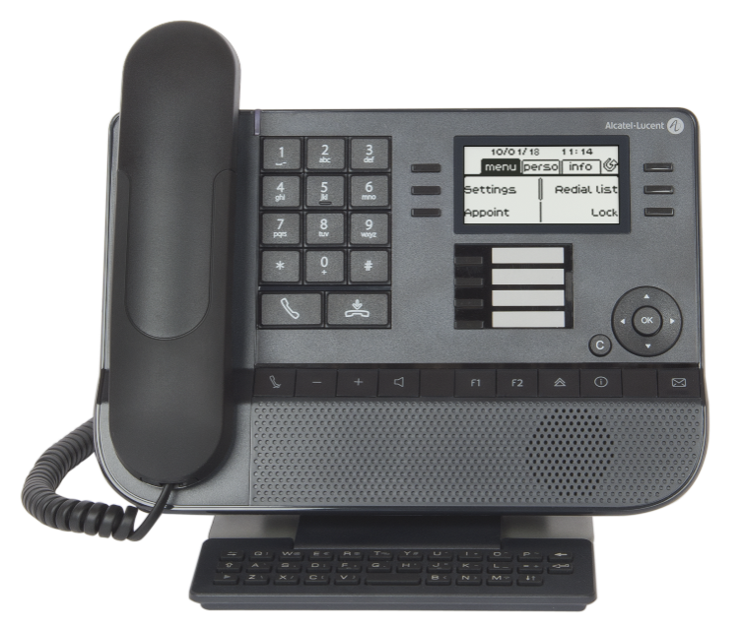
8029s Premium DeskPhone Premium phone for intensive usage. Digital.
Collaboration
Mobility
IP phones
What our customers like
Comfort handset
Ease of use with 6 contextual keys, 4 labeled speed-dial keys, backlit screen and integrated keyboard
Digital connectivity: no IP/POE, power supply requirement
Benefits
Visual comfort: backlit multi-line display with contextual keys
Easy directory lookup and ALE features/navigation
Cost-effective digital connectivity
Options
3MG27105AC Premium 10 keys add-on module S
3MG27107AC Premium Smart display 14 keys module S
3MG27106AC Premium 40 keys add-on module S
Digital phones
Other phones
DECT handsets
WLAN handsets
Greeting
Routing
DECT/IP DECT
WLAN
Short description Offers the richest communication experience with high level of comfort in use. Easy-to-use with 4 function keys, 6 interactive keys and alphabetic keyboard. 3.5 mm Jack or RJ9 connectivity for headsets. Backlit screen. Digital connectivity. Low power consumption.
LAN
Hospitality
Multi-line display
External keyboard
Cost-effective digital connectivity
Platform,
Services

Slide 20
8019s DeskPhone Compact phone for intensive usage. Digital.
Collaboration
Mobility
IP phones
What our customers like
Compact model
Ease of use with 6 contextual keys, 4 labeled speed-dial keys, backlit screen and compact design
Jack port for headset
Benefits
Visual comfort: backlit multi-line display with contextual keys
Audio comfort: high-quality handsfree and handset
Customer-focus: ALE features/navigation
Options
• 3MG27210AA: Wall mounting kit
• 3GV28057xx: Binaural 3,5mm Headset
• Spare parts: Customizable clip, paper label covers
Digital phones
Other phones
DECT handsets
WLAN handsets
Greeting
Routing
DECT/IP DECT
WLAN
Short description Offers the richest communication experience with high level of comfort in use. Easy-to-use with function keys, interactive keys. White backlit screen. Digital technology. Low power consumption.
LAN
Hospitality
White backlit screen
Compact model
4 speed-dial keys
Platform,
Services

Slide 21
Hot desking On-demand mode for business phones. Mobile workers. Shared desks
Collaboration
Mobility
IP phones
What our customers like
Each phone can be used on demand when a “Hot Desking user” authenticates
Web supervision tool. View available phones, busy phones, who is using them, log off any user.
Built-in service offered to all wired phones
Benefits
A flexible solution to use a phone on demand
Shared desks to optimize office workplace
Easy management of phones in a free seating
Digital phones
Other phones
DECT handsets
WLAN handsets
Greeting
Routing
DECT/IP DECT
WLAN
Short description Practice of not assigning permanent desk and phone in a workplace, so that employees may work at any available desk. Each phone can be used on demand when a “Hot Desking user” authenticates. Supported on 8008 DeskPhone, 8018 DeskPhone, Premium DeskPhones, s Series Premium DeskPhones, IP Desktop Softphone, analogues POTS. Web supervision tool.
LAN
Hospitality
On-demand phones
Login: the phone retrieves your settings
Web-based management
Platform,
Services

Slide 22
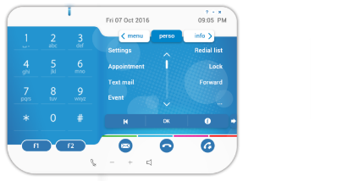
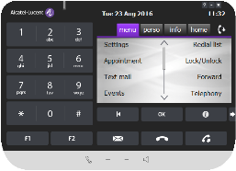
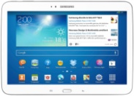
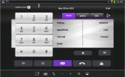



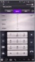

IP Desktop Softphone Software phone for PC, Mac, tablets and smartphones
Collaboration
Mobility
IP phones
What our customers like
IP desktop softphone licenses is all what you need
Leverage the company VPN for off-site/remote worker usages
No mix between private and professional life (Android)
Benefits
Employees who have no physical desk phones are always reachable on computer, tablet or smartphone
Employee efficiency: all telephony services are available
No additional user training when users know the DeskPhones
Digital phones
Other phones
DECT handsets
WLAN handsets
Greeting
Routing
DECT/IP DECT
WLAN
Short description User-friendly and easy to install, the IP Desktop Softphone offers all the 8068 Premium DeskPhone features on PC, Mac or Android in the office. It turns your computer or mobile into an high-end enterprise grade VoIP phone at the price of a regular set. Cost-effective: no additional server required. As easy to manage as a DeskPhone
LAN
Hospitality
Zero additional server
On any device
Same experience as a phone
Platform,
Services

Slide 23
PIMphony Touch/Pro/Team PC-based phone companion
Collaboration
Mobility
IP phones
What our customers like
Intuitive user interface to control a business phone
See at a glance who is available for a call
Unified messaging and call log: zero lost call!
Benefits
Simplify your phone tasks
Increase efficiency and save time
Keep track of calls during absences
Variants
PIMPhony Touch: Windows 8, 10
PIMPhony Pro: screen pop
PIMphony Teams: workgroups
PIMphony Attendant to handle a large number of incoming calls : single or multisite PC-based Attendant
Digital phones
Other phones
DECT handsets
WLAN handsets
Greeting
Routing
DECT/IP DECT
WLAN
Short description Windows companion application. Associated with any device except SIP phones. Full featured telephony. Intuitive interface for call control. Centralized call log. Programmable call shortcut keys. Directory look-up. Click-to-call. Screen pop-up. Workgroups (status availability of phones). Visual voice mail, routing rules, record on line, unified messaging, instant messaging.
LAN
Hospitality
Intuitive click-to-call
Easy phone control
Built-in application
Platform,
Services

Slide 24
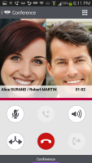
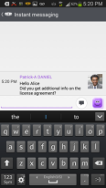
OpenTouch Conversation for Android One number
Collaboration
Mobility
IP phones
What our customers like
On-site and off-site mobility
Directory access while on the go
3-way conference made easy
Benefits
Ensure business continuity, anytime and anywhere
Free voice on WLAN hotspots
Digital phones
Other phones
DECT handsets
WLAN handsets
Greeting
Routing
DECT/IP DECT
WLAN
Short description Application available on Google Play Store, free of charge. Routing Rules, Mobility Management. In conversation services, Transfer, Conference. Forward options: forward, redirect. Call logs. Visual voice mail. Unified Instant Messaging. Dial-by-name, Unified Directory Access. VoIP option (VPN). Secured access to the enterprise (https + login/password). Business & Private modes management
LAN
Hospitality
On-site/off-site mobility
One number service
Built-in application
Platform,
Services

Slide 25
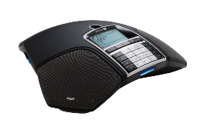
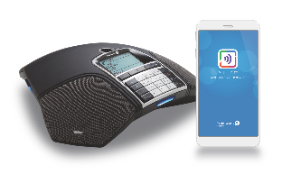
SIP Conference Phones
Collaboration
Mobility
IP phones
Digital phones
 | 4135 | 8135s
Key highlights at a glance | High-quality audio conferencing | Start a meeting in one tap from mobile app
Bluetooth pairing with ALE Unite mobile app (control) |  | ■
NFC pairing with smartphone (pairing, download) |  | ■
USB port to connect a PC (audio) |  | ■
Expansion microphones | ■ | ■
360° high quality sound | ■ | ■ (*)
Web-based configuration | ■ | ■
Record on SD card | ■ | ■
Access to external LDAP directory | ■ | ■
Unicode support |  | ■
Local five-way audio bridge | ■ | ■
Connectivity | SIP | SIP
Other phones
DECT handsets
WLAN handsets
Greeting
Routing
DECT/IP DECT
WLAN
(*) Supports OPUS codec
LAN
Hospitality
Intuitive experience from dial-pad or mobile app
Excellent voice quality
At the desk or in meeting room (70m²)
Platform,
Services

Slide 26
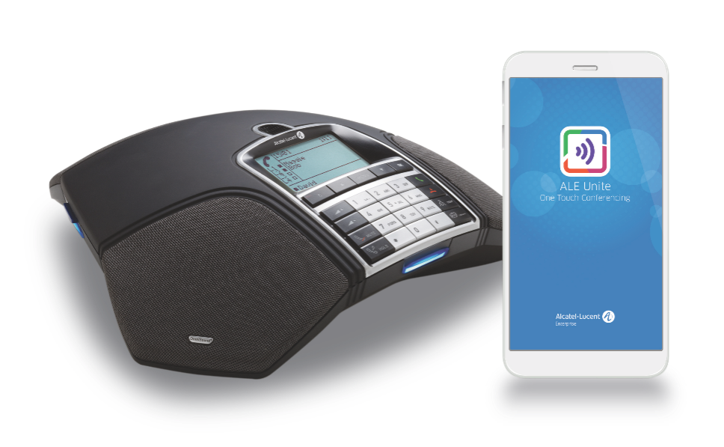



8135s IP Conference Phone SIP conference phone controlled by smartphone
Collaboration
Mobility
IP phones
What our customers like
Easily control the phone from your smartphone with first pairing over NFC and with call management over Bluetooth
Built-in conference capabilities up to 5 locations
360° high quality sound with OnmiDirectional microphones covering up to 70m² (750ft²)
Benefits
Improves audio in large meeting rooms, eliminates background noise
Offers one-click-calls with ALE Unite mobile app
Keep track of your team calls, save, share, play them on PC
Options
ALE Unite app (Google Play, Apple Store)
3GV28133AA Power adaptor
3GV28134AA Expansion microphones: expands coverage from 30 m2 to 70 m2
Digital phones
Other phones
DECT handsets
WLAN handsets
Greeting
Routing
DECT/IP DECT
WLAN
Short description SIP conference phone offering high quality audio conference and fast meeting setup: conference management from Unite app, calls to preprogrammed groups, conference recording. Enhances collaboration and enables creative exchanges with remote contacts. Reduces time and cost of travels and administration. POE. LDAP directory access. Web management. 4 user profiles. Record calls with integrated SD memory card. Up to 5 participants. Connect your PC softphone via the USB port.
LAN
Hospitality
Meeting Up to 5 participants
Start a meeting in one tap from mobile app
At the desk or in meeting room (70m²)
Platform,
Services

Slide 27
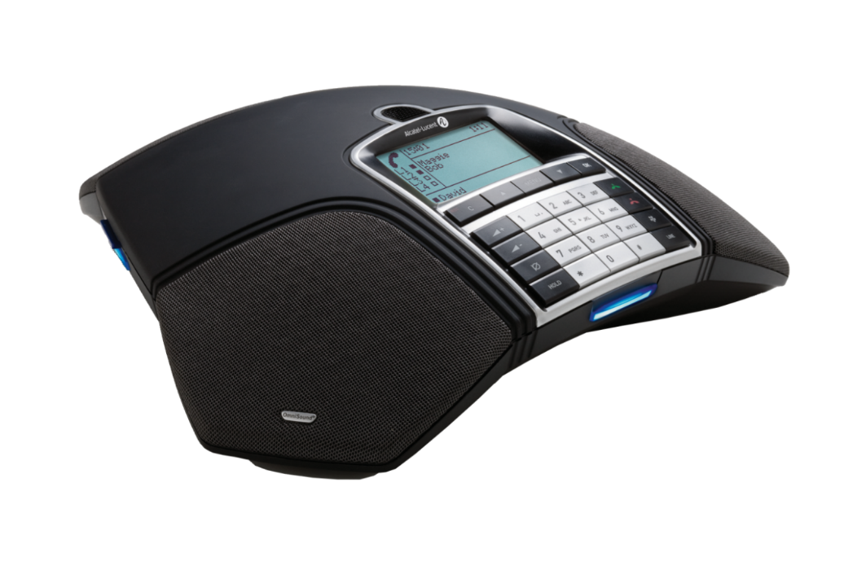
4135 IP Conference Phone SIP conference phone for meeting rooms, personal conference.
Collaboration
Mobility
IP phones
What our customers like
Record calls with integrated SD memory card
Built-in conference capabilities up to 5 locations
360° high quality sound with OnmiDirectional microphones covering up to 70m² (750ft²)
Benefits
Improves audio in large meeting rooms, eliminates background noise
Enables high-quality audio conferencing
Keep track of your team calls, save, share, play them on PC
Options
3GV28133AA Power adaptor
3GV28134AA Expansion microphones: expands coverage from 30 m2 to 70 m2
Digital phones
Other phones
DECT handsets
WLAN handsets
Greeting
Routing
DECT/IP DECT
WLAN
Short description SIP conference phone offering innovative conferencing features for high quality audio conference and efficient meetings: calls to preprogrammed groups, conference recording. Enhances collaboration and enables creative exchanges with remote contacts. Reduces time and cost of travels and administration. POE. LDAP directory access. Web management. 4 user profiles. Up to 5 participants.
LAN
Hospitality
Meeting Up to 5 participants
Conference recording
At the desk or in meeting room (70m²)
Platform,
Services

Slide 28
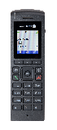
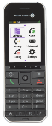
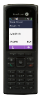
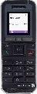
Collaboration
Mobility
IP phones
 | 8212 | 8232 | 8242 | 8262 | 8262EX
Key highlights at a glance | Enterprise-grade GAP handset | ALE features and navigations | Large backlit screen and Bluetooth headset | Rugged IP65 design (dust, water jets), Bluetooth headset | ATEX
Rainbow connected | ■ | ■ | ■ | ■ | ■
Industry/mission-critical features | - | - | Emergency Alarm / Notifications | Embedded alarm app. / Isolated Worker Protection / Notifications
Bluetooth Low Energy (beacons) | - | - |  | ■ | ■
Bluetooth headset | - | - | ■ | ■ | ■
Programmable keys | 0 | 0 | 2 | 2 | 2
Screen size | Standard | Standard | Large | Large | Large
Backlit / color screen | ■ /  | ■ /  | ■ /  | ■ /  | ■ / 
Hands-free speakerphone | ■ | ■ | ■ | ■ | ■
Talk time before recharge | 11h | 20h | 17h | 20h | 20h
Enterprise directory | Local/OXO Connect | ■ | ■ | ■ | ■
ALE twinset with business phone | ■ | ■ | ■ | ■ | ■
ALE features and navigation | - | ■ | ■ | ■ | ■
Reliability: Ingress Protection | IP40 | IP40 | IP40 | IP65 | IP65
Radio | DECT GAP | DECT AGAP | DECT AGAP | DECT AGAP | DECT AGAP
Digital phones
Other phones
DECT handsets
WLAN handsets
Greeting
Routing
DECT/IP DECT
WLAN
LAN
Hospitality
Excellent voice quality
ALE business communications
Robust and reliable handsets
Platform,
Services

Slide 29
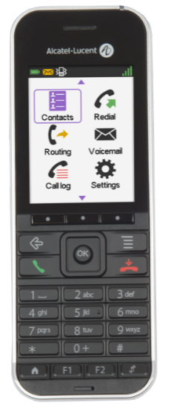
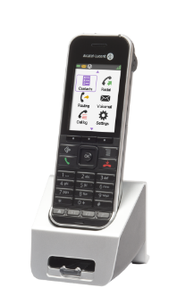
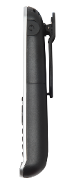
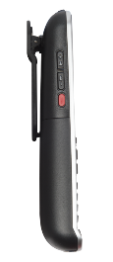
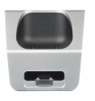
8242 DECT Handset Wireless phone for intensive use. Premium experience
Collaboration
Mobility
IP phones
What our customers like
All business telephony services as if at the desk
Large backlit screen to ease reading and Bluetooth headset for convenient hands-free mode
Long-life battery up to 17 hours talk time
Benefits
Digital DECT and IP-DECT connectivity
Answer calls immediately, wherever you are. No call backs, instant call treatment
Long talk time: economy mode automatically uses low radio emission power (25 mW peak)
Options
3BN67343AA Vertical pouch with Belt clip
3BN67344AA Horizontal pouch with Belt clip
3BN67215WW BT Plantronics Voyager Legend
3BN67341AA Handset dual charger
3BN67331AB Handset desktop charger
Spares parts (batteries, charger, adaptor)
Digital phones
Other phones
DECT handsets
WLAN handsets
Greeting
Routing
DECT/IP DECT
WLAN
Short description Convenient and easy to-use wireless phone with option for Bluetooth headset. Offers lone worker protection via the alarm key. Works with DECT and IP-DECT base stations. Long battery life. Low power consumption and radio emission. Hands-free audio. Built-in vibrate mode. Large color screen. Backlit keypad and screen. 3.5mm headset output or option for Bluetooth headset.
LAN
Hospitality
ALE business communications and navigation
XL screen size
Built-in Bluetooth
Platform,
Services

Slide 30
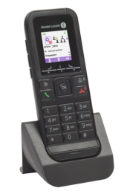
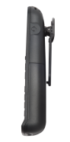
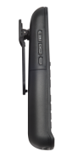
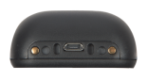
8232 DECT Handset Wireless phone for intensive use.
Collaboration
Mobility
IP phones
What our customers like
All business telephony services as if at the desk
Extra long-life battery up to 20 hours talk time
Benefits
Digital DECT and IP-DECT connectivity
Answer calls immediately, wherever you are. No call backs, instant call treatment
Long talk time: economy mode automatically uses low radio emission power (25 mW peak)
Options
3BN67334AA Handset swivel clip
3BN67337AA Vertical pouch with Belt clip
3BN67338AA Horizontal pouch with Belt clip
3BN67359AA Protective rubber case with swivel clip
3BN67341AA Dual charger
3BN67331AB Handset desktop charger
Spares parts (batteries, charger, adaptor)
Digital phones
Other phones
DECT handsets
WLAN handsets
Greeting
Routing
DECT/IP DECT
WLAN
Short description Convenient and easy to-use wireless phone for mobile business communications in demanding environments such as industry and healthcare. Works with DECT and IP-DECT base stations. Extra long battery life. Low power consumption and radio emission. Hands-free audio. Built-in vibrate mode. Color screen. Backlit keypad and screen. 3.5mm headset output.
LAN
Hospitality
ALE business communications and navigation
20H talk-time
Robust enterprise-grade design
Platform,
Services

Slide 31
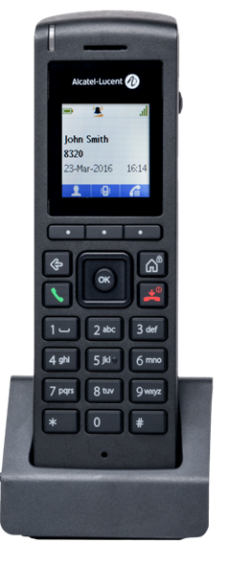
8212 DECT Handset Wireless phone for staff. Entry level
Collaboration
Mobility
IP phones
What our customers like
Robust compact design: IP40 ingress protection (vs IP20 average market)
Affordable GAP handsets with hands-free and headset output, backlit color screen
Personal directory and call log (50 entries)
Benefits
Compact model with enterprise-grade, robust design
No lost call with call log
Central management from Communication Servers
Options
3BN67352AA Vertical pouch
3BN67358AA Belt clip (x5)
Spare parts (charger, power adaptor)
Digital phones
Other phones
DECT handsets
WLAN handsets
Greeting
Routing
DECT/IP DECT
WLAN
Short description Simple and affordable model for basic on-site mobility needs in the enterprise. Compact handset with color screen and intuitive navigation: 3 softkeys, 4-way navigation plus OK button. Personal directory. Local call log. Hands-free audio. 3,5mm jack/USB with flash loader. GAP standard. IP40. Supplied with charger and 2xAAA Batteries. OXO Connect directory (TDM DECT)
.
LAN
Hospitality
Enterprise-grade design
Personal directory, call log
Centrally-managed
Platform,
Services

Slide 32
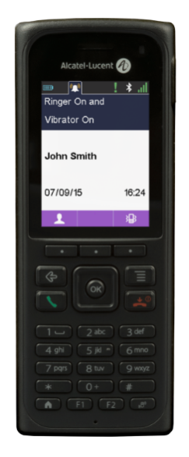



8262 DECT/ 8262 Ex DECT Handset Rugged industrial wireless phone
Collaboration
Mobility
IP phones
What our customers like
Tough business phone : shock resistant, water splash and dust proof, IP65 standard.
All business telephony services as if at the desk
Notification services integration
Benefits
Business telephony services for people working in challenging environments
Illuminated keypad: get calls in low light situations
Save lives: alarm, notification and location services coupled with an external alarm server
Options
3BN67347AA Pull cords (x2)
3BN67352AA Vertical pouch
3BN67346AA Dual charger for 8262
3BN67351AA Rack charger for 8262
Spare parts (charger, power adaptor, Accessories kit)
Digital phones
Other phones
DECT handsets
WLAN handsets
Greeting
Routing
DECT/IP DECT
WLAN
Short description Light and tough business phone with shock-resistant screen for demanding environments (IP65) such as workshops, warehouses, factories, petrol and gas industries. Provides mobile business communications with great ease of use: large color screen, HD audio. Lone worker protection features such as man-down, no movement, pull-cord and shock detection, alarm button, geo-location. Built-in 4.1 Bluetooth technology. Low power consumption.
LAN
Hospitality
Rugged and reliable
Alarms, notification, geo-location integrations
Worker protection
Platform,
Services

Slide 33


DECT Intercom Wireless intercom / call box
Collaboration
Mobility
IP phones
What our customers like
Wireless communications: zero LAN requirements
Instant wireless pairing and centrally managed device
Reach all staff members with ALE phones
Benefits
Customer satisfaction: easily reach sales man or receptionist
One communication system for Intercom and business communications
Easy to install, to move, to customize
Digital phones
Other phones
DECT handsets
WLAN handsets
Greeting
Routing
DECT/IP DECT
WLAN
Short description Wireless audio intercom for in-door use. Ideal call box for retail stores and warehouses. Press the key and instantly become in touch with staff members using A-L DECT handsets or desk phones. Clear audio quality. Instant wireless pairing and centralized management for cost-effective operations. Requires power supply. No LAN cabling: easy to move to another location. Easy to customize.
LAN
Hospitality
Wireless call box
Instant pairing
Reach all ALE phones
Platform,
Services

Slide 34


Collaboration
Mobility
IP phones
Digital phones
 | 8118 | 8128
Key highlights at a glance | ALE features and navigation | Color screen, industry features
Rainbow connected | ■ | ■
Industry/mission-critical features | - | Push to talk button, alarm button
Screen size | Standard | Standard
Backlit / color screen | ■ / - | ■ / 
Hands-free speakerphone | ■ | ■
Talk time before recharge | 15h | 15h
Enterprise directory | ■ | ■
ALE twinset with business phone | ■ | ■
ALE features and navigation | ■ | ■
Reliability: Ingress Protection | IP44 | IP44
Radio | WLAN | WLAN
Other phones
DECT handsets
WLAN handsets
Greeting
Routing
DECT/IP DECT
WLAN
LAN
Hospitality
One network
for voice and data
Robust design (IP44)
ALE business communications and navigation
Platform,
Services

Slide 35





8128 WLAN Handset Wireless phone for Wifi networks. Color screen. Alarms
Collaboration
Mobility
IP phones
What our customers like
All business telephony services as if at the desk
Robust compact design: IP44 ingress protection (water spray proof)
Push-to-talk and alarm button for industry
Benefits
Answer calls immediately, wherever you are
Always-on availability: robust design, long talk-time
Reduce costs: single Wi-Fi infrastructure for voice and data
Options
3BN78403xx* Handset desktop charger
3BN78406AA Rack charger WW
3BN78404AA Standard battery
3BN78407AA Batteries Rack charger WW
3BN78408AA Leather pouch
3BN78409AA Belt clip
3BN78410AA Swivel clip
Digital phones
Other phones
DECT handsets
WLAN handsets
Greeting
Routing
Push-to-talk
DECT/IP DECT
WLAN
Short description Convenient and practical on-site mobility. WiFi connectivity: IEEE 802.11a/b/g radio with Quality of Service IEEE 802.11e and WMM, single infrastructure for voice and data services. Intuitive ALE navigation and features (directory, call log, forward and mid call services). Color screen. Backlit display, dial-pad. Vibrator mode. Alarm button on the top. Push-to-talk button.
LAN
Hospitality
Enterprise-grade design
15H talk time
Push-to-talk and alarm button
Platform,
Services

Slide 36

8118 WLAN Handset Wireless phone for Wifi networks.
Collaboration
Mobility
IP phones
What our customers like
All business telephony services as if at the desk
Robust compact design: IP44 ingress protection (water spray proof)
Benefits
Answer calls immediately, wherever you are
Always-on availability: robust design, long talk-time
Reduce costs: single Wi-Fi infrastructure for voice and data
Options
3BN78403xx* Handset desktop charger
3BN78406AA Rack charger WW
3BN78404AA Standard battery
3BN78407AA Batteries Rack charger WW
3BN78408AA Leather pouch
3BN78409AA Belt clip
3BN78410AA Swivel clip
Digital phones
Other phones
DECT handsets
WLAN handsets
Greeting
Routing
DECT/IP DECT
WLAN
Short description Convenient and practical on-site mobility. WiFi connectivity: IEEE 802.11a/b/g radio with Quality of Service IEEE 802.11e and WMM, single infrastructure for voice and data services. Intuitive ALE navigation and features (directory, call log, forward and mid call services). Backlit display. Vibrator mode.
.
LAN
Hospitality
Enterprise-grade design
15H talk time
ALE business communications and navigation
Platform,
Services

Slide 37

Greeting messages.
Collaboration
Mobility
IP phones
Welcome to…
Press 1 to ..
What our customers like
Up to four customizable company greetings
Dedicated 10-min customized music-on-hold
Four system languages
Benefits
Enhanced welcome
Information available 24/7
Direct transfer to the right contact
Options
Automated attendant: One tree, two levels
Multiple automated attendant: Up to four languages, Up to five different trees, Three levels with ten choices per tree
Multiple company welcome
Smart Call Routing
Digital phones
Other phones
DECT handsets
WLAN handsets
Greeting
Routing
DECT/IP DECT
WLAN
Short description
LAN
Hospitality
Built-in service
Customized music-on-hold
4 languages
Platform,
Services

Slide 38



Integrated voicemail All business calls get an answer
Collaboration
Mobility
IP phones
What our customers like
Single voicemail for all location
Visual notification (LED on phone)
Fast voicemail consultation (mailbox key) with intuitive contextual menus and vocal guidance
Benefits
All calls get an answer with professional greetings
Easy to install and upgrade: No additional hardware
Large feature set to meet all employee needs
Options
3EH03529AA 4 hours storage license
3EH03530AA 30 hours
3EH03531AA 200 hours
3EH03532AA 2 additional ports
Digital phones
Other phones
DECT handsets
WLAN handsets
Greeting
Routing
DECT/IP DECT
WLAN
Short description Voice mail: two ports and 60 min. Personal message greeting. LED on phone plus external notification. Forwarding to voice mail. Password protection. Remote consultation. Voice mail available on analog and wireless extensions. Unified messaging (voice mail in e-mail). 4 / 30 / 200 hours storage memory. Up to eight ports. Online recording (on-demand/or automatic). Distribution lists. Remote customization.
LAN
Hospitality
Integrated solution
Professional and personalized welcome
All calls get an answer
Platform,
Services

Slide 39


Phone attendant console Personalized professional answer. Built-in application.
Collaboration
Mobility
IP phones
What our customers like
Mutual aid of attendants
Intuitive navigation
Instant line supervision with key modules
Benefits
Professional welcome
Easy to manage and understand
Ergonomically enhanced
Digital phones
Other phones
DECT handsets
WLAN handsets
Greeting
Routing
DECT/IP DECT
WLAN
Short description High-end phone. Internal and external call monitoring. Eight attendant groups. Eight attendants in a group. Internal or external forwarding.
LAN
Hospitality
Personalized greeting
Attendant groups
Contextual menus
Platform,
Services

Slide 40

PIMphony Team, Attendant Software attendant console
Collaboration
Mobility
IP phones
What our customers like
Up to 15 inbound calls managed simultaneously
Single-click transfers
Multisite supervision and management screen (Attendant)
Benefits
Professional welcome for high traffic
Single receptionist for multiple sites
PC-based ergonomics and efficiency
Digital phones
Other phones
DECT handsets
WLAN handsets
Greeting
Routing
DECT/IP DECT
WLAN
Short description Up to 15 inbound calls managed simultaneously. Single-click transfers. Text messages. Deflect transfer to voice mail. Contact card screen pop. Multisite supervision and management screen (Attendant). Rich extension information status. Centralized phone book for up to ten sites. Headset
LAN
Hospitality
Handle large number of incoming calls
Centralized phonebook up to 10 sites
Put calls through to available staff members
Platform,
Services

Slide 41

Automated Attendant.
Collaboration
Mobility
IP phones
What our customers like
Open and closed hours menus
Fax switch
Customization of prompts.
Benefits
Greet and guide callers.
A professional company welcome and routing, any time, any day
Alternative or complement to a human attendant position
Options
Multiple Automated Attendant
Digital phones
Other phones
DECT handsets
WLAN handsets
Greeting
Routing
DECT/IP DECT
WLAN
Short description Menus: One tree, two levels. 4 functions available: Pre-configured auto-attendant, Customized auto-attendant, Audiotex, Fax & modem switch. Open hours & Closed hours distinct menus. 10 choices per menu. Actions: direct dial, user/mailbox, attendant, information, release. Statistics
LAN
Hospitality
Open and closed hours
Customized prompts
Fax switch
Platform,
Services

Slide 42
Multiple Automated Attendant.
Collaboration
Collaboration
Mobility
Mobility
IP phones
IP phones
What our customers like
Menus for multiple brands/companies/languages
Fax switch
Customization of prompts.
Benefits
Reflect multiple organizations or languages
A professional company welcome, any time, any day
Alternative or complement to a human attendant position
Options
3EH03536AA 1 tree software license
3EH03537AA 5 trees software license
3EH03538AA 1 tree to 5 trees software license
Digital phones
Digital phones
x5
Other phones
Other phones
DECT handsets
DECT handsets
WLAN handsets
WLAN handsets
Greeting
Greeting
Routing
Routing
DECT/IP DECT
DECT/IP DECT
WLAN
Short description Multi-companies or multi-brand companies. Multi-language companies. Advanced, high-level automated attendant needs. 1 to 5 trees. 3 levels with 10 choices per menu. Up to 100 voice prompts max for the 5 trees. Actions: Play a voice prompt/message; Transfer to: Subscriber, Group, Attendant, External number; Jump to a menu of the tree.
.
WLAN
LAN
LAN
Hospitality
Hospitality
Multiple companies/languages
Up to 100 prompts
Transfer to groups
Platform,
Services
Platform,
Services

Slide 43
Smart Call Routing.
Collaboration
Mobility
IP phones
What our customers like
Powerful customization capabilities
VIP service uses customer account codes
Benefits
Customers only have to know one number
A personalized company welcome
Faster response: Connect to most relevant people
Options
Additional licenses for MLAA & ACD
Specific bundle for SCR+ACD (commercial reference)
Digital phones
Other phones
SCR
Welcome agents (ACD) Multiple Automated Attendant
DECT handsets
Incoming call
WLAN handsets
rules
Business phones External numbers
Greeting
Routing
DECT/IP DECT
WLAN
Short description Multi-criteria rules to connect quickly customer or partner incoming calls to the right company destination. Criteria: caller number, called number, account code.
LAN
Hospitality
Connect to the relevant expert
VIP service
Customized routing
Platform,
Services

Slide 44



Welcome - Automatic Call Distribution.
Collaboration
Mobility
IP phones
What our customers like
Built-in ACD capabilities
Intuitive use from business phone or desktop client
Statistics
Benefits
Route calls to the most skilled person
Easily handle incoming calls
Greet callers with a professional welcome
Options
PC-based agent and supervisor applications
Agent Assistant: user-friendly facilities to increase agents’ quality of welcome and performance
Supervisor console with real-time traffic statistics and groups’/agents’ performance analysis; up to eight supervisors and three presentation modes
Statistic Manager
PIMphony Pro: With screen pop-ups
Digital phones
Other phones
DECT handsets
WLAN handsets
Greeting
Routing
DECT/IP DECT
WLAN
Short description Automatic call routing: Caller identification, direct dialing identification, automated attendant. Automatic call distribution: Rotating priority, fixed priority, longest idle time. Waiting queue management: Up to eight groups and 32 active agents, six customized messages per group, handle VIP calls (Visual Queue Control). Automatic agent connection upon time-out
LAN
Hospitality
Built-in distribution
32 active agents
Statistics and reporting
Platform,
Services

Slide 45




DECT/IP DECT Base stations.
Collaboration
Mobility
IP phones
Digital phones
 | 8379 | 8378 | 8340 | 8318
Connectivity | Digital | IP | SIP | SIP
Site | Main site, branch | Main site, branch | Campus, branch | Small branch, SOHO (up to 20 handsets)
Models | Indoor, outdoor, Ex | Indoor, outdoor | Indoor, outdoor | Indoor
Roaming/Handover⁽¹⁾ | ■ | ■ | ■
Antennas | Internal/external | Internal/external | Internal/external | Internal
ALE Handsets | 8212, 8232, 8242, 8262, 8262EX | 8212, 8232, 8242, 8262, 8262EX | 8212, 8232, 8242 | 8212
Third-party GAP Handsets | ■ | ■ | ■
Centralized management | ■ | ■ | ■ | ■
Other phones
DECT handsets
WLAN handsets
Greeting
Routing
DECT/IP DECT
WLAN
LAN
Legacy 8340 should be positioned only for add-ons
Hospitality
IP or Digital choice
Excellent voice quality
Centralized management from Communication Server
Platform,
Services
(1) Handover only across same types of base stations (e.g between 8379 base stations)

Slide 46



8379 DECT IBS On-site mobility DECT radio coverage. Digital. Indoor, outdoor models
Collaboration
Mobility
IP phones
What our customers like
High density = less stations than WLAN
Same feature level as DeskPhone
Cost effective digital connection. 6 simultaneous radio communications per station.
Benefits
Indoor and outdoor mobility with multi-cell, roaming, handover and security
Cost-effective TDM cabling: zero-touch on IP network
> 100 m cabling: no extra switch needed
Options
3BN67172AA Explosion proof model 4070 IO-Ex
Wall mounting kit, external antennas, connectors, cords
Digital phones
Other phones
DECT handsets
External antennas
WLAN handsets
Greeting
Routing
Outdoor
DECT/IP DECT
WLAN
Short description Provides DECT (Digital Enhanced Communication Technology) connectivity for a cost-effective and high-performance on-site mobility service. Offers reliable business communications for on site mobility with roaming and handover between sites. Integrated antenna. Digital connectivity. Indoor and outdoor models. Centralized management.
LAN
Hospitality
Expert ALE business communications
Cost-effective digital cabling
High-density coverage
Platform,
Services

Slide 47

8378 DECT IP-xBS On-site mobility IP-DECT radio coverage. Indoor, outdoor models
Collaboration
Mobility
IP phones
What our customers like
Same feature level as DeskPhone
Automated provisioning and over-the-air synchronization
Roaming with 8379 DECT on another site
Benefits
Zero-touch deployment
Expert communications and excellent voice quality
Centralized management
Options
3BN67365AA 8378 DECT IP-xBS integrated antennas
3BN67366AA 8378 DECT IP-xBS for external antennas
3BN67367AA 8378 DECT IP-xBS OUTDOOR with external antennas.
3BN67185AA 8 dBi Gain antenna, 3BD52212AA 7,5 dB Gain antenna
3BD52205AA 8dB right circular antenna, 3BD52206AA 8dB left circular antenna
3MG27035xx PoE injector
Digital phones
Other phones
DECT handsets
WLAN handsets
IP
Greeting
Routing
DECT/IP DECT
WLAN
Short description Provides a robust infrastructure for Digital Enhanced Cordless Telecommunications (DECT) in buildings and outdoors, to connect mobile workers everywhere. The unique radio tuning capabilities and on-air synchronization enable network coverage in most difficult areas. GAP/AGAP. Centralized management. No IP network customization. 11 calls/station. POE: no additional power supply and cabling
LAN
Hospitality
GAP business communications
High-density coverage even in difficult areas
Leverage IP network for voice
Platform,
Services

Slide 48

8340 Smart IP-DECT Access Points On-site mobility IP-DECT radio coverage
Collaboration
Mobility
IP phones
What our customers like
Same feature level as DeskPhone
IP connection. 11 simultaneous radio comms per station
1 switch + 1 IP DECT station = remote site mobile telephony
Benefits
Provide on site mobility on full IP networks
Adapted for all environments: office and industrial
Coverage can fit most difficult areas by use of external antennas
Options
3BN67185AA 8dBi Gain Antenna with external antennas
3MG27035xx PoE injector
3BN67184AA Isolated Outdoor Box
Digital phones
Other phones
DECT handsets
WLAN handsets
IP
Greeting
Routing
DECT/IP DECT
WLAN
Short description Provides DECT (Digital Enhanced Communication Technology) connectivity for a cost-effective and high-performance on-site mobility service. Offers reliable business communications for on site mobility with roaming and handover between sites. Integrated antenna. IP connectivity to connect to the company network (LAN). Indoor and outdoor models. POE: no additional power supply and cabling
LAN
Hospitality
Expert ALE business communications
High-density coverage
Leverage IP network for voice
Platform,
Services

Slide 49

8318 Single Cell SIP Base Station On-site mobility IP-DECT for Small Office and Home Office
Collaboration
Mobility
IP phones
What our customers like
Affordable on-site mobility
Centralized management done by Communication Server
Ideal solution for very small branch offices (up to 20 handsets) with no roaming requirements
Benefits
Reliable on-site mobility for small branch offices
Low operation costs: scalable solution for a large number of small branches
Cost-effective “one-vendor” solution
Options
3BN07006AA 8318 SIP-DECT Single Base Station + 1x8212 DECT Handset with Desktop charger
Digital phones
Other phones
Small offices
DECT handsets
WLAN handsets
8212
IP
Greeting
8318
Routing
DECT/IP DECT
WLAN
Short description Provides DECT (Digital Enhanced Communication Technology) connectivity for a cost-effective on-site mobility service in small offices and branches. Integrated antenna. IP connectivity to connect to the company network (LAN). Single Cell, no roaming, no handover. Only with cost-effective 8212 device.
LAN
Hospitality
Very small branch offices
Cost-effective solution and operations
Leverage IP connectivity
Platform,
Services

Slide 50










Collaboration
Mobility
OmniAccess® Stellar WLAN
IP phones
Digital phones
Other phones
DECT handsets
WLAN handsets
AP1251 802.11ac Wave 2 2 radios
2×2:2 @ 2.4GHz
2×2:2 @ 5GHz
2xGE
DPI
Greeting
AP1231/AP1232
802.11ac Wave 2 3 radios
4×4:4 @ 2.4GHz
Dual 4×4:4 @ 5GHz
BLE
1xGE + 1x2.5GbE
DPI
Routing
AP1201 802.11ac Wave 2 2 radios
2×2:2 @ 2.4GHz
2x2:2 @ 5GHz
BLE, Zigbee
1 GE port
DPI
AP1221/AP1222
802.11ac Wave 2 2 radios
2×2:2 @ 2.4GHz
4×4:4 @ 5GHz
BLE w/USB
1 GE Port DPI
AP1201H 802.11ac Wave 2 2 radios
2×2:2 @ 2.4GHz
2x2:2 @ 5GHz
BLE w/USB
1 GE port
3x GE downlink
RJ45 Passthrough
DECT/IP DECT
AP1101 802.11ac Wave 1 2 radios
2×2:2 @ 2.4GHz
2x2:2 @ 5GHz
1 GE port
WLAN
LAN
Hospitality
Platform,
Services

Slide 51

Alcatel-Lucent OmniAccess® Stellar AP1101 On-site mobility
Collaboration
Mobility
IP phones
Key benefits
Ideal for SMB organizations
Entry-Level indoor AP for small and medium density deployment
High performance Gigabit Access Point, 802.11ac Wave1
Enabling excellent performance with simplicity
Enhanced Radio Dynamic AdjustmentTM with DFS/TPC
Integrated Simple Guest Management
Built-in customizable captive portal
Support of Role based Management Access
Seamless Roaming for Real Time Applications
AP-Group Architecture
Zero Touch Provisioning
Options
OmniAccess® Stellar Mounting Kit for:
T shaped ceiling rail mounting (OAW-AP-MNT-B)
Wall mounting and ceiling mounting (OAW-AP-MNT-W)
Other shaped ceiling rail mounting (OAW-AP-MNT-C)
Power Injector PoE Midspan (PD-9001GR/AT/AC)
48V/30W AC-to-DC Power Adapter (ADP-30HRBD)
Digital phones
Other phones
DECT handsets
WLAN handsets
Greeting
Routing
DECT/IP DECT
WLAN
Short description 802.11 a/b/g/n/ac Wave1. Dual radio 2x2, 2 spatial streams, 1 GbE network interface, Up to 1,2 Gbps data rates, IEEE 802.3af Power over Ethernet (PoE) sourcing, Up to 32(*) AP per cluster, 256 concurrent clients and 16 SSID
LAN
Hospitality
Platform,
Services
(*) 64 AP per cluster if there are 4 x APs of higher family (AP12xx)

Slide 52

Alcatel-Lucent OmniAccess® Stellar AP1201 On-site mobility
Collaboration
Mobility
IP phones
Key benefits
Ideal for SMB organizations
Indoor AP for small and medium density deployment
High performance Gigabit Access Point, 802.11ac Wave2
Enabling excellent performance with simplicity
Enhanced Radio Dynamic Adjustment with DFS/TPC
Integrated Simple Guest Management
Built-in customizable captive portal
Support of Role based Management Access
Seamless Roaming for Real Time Applications
Voice over WLAN
Bluetooth Low Energy (BLE) 5.0 radio, integrated antenna.
Hardware ready for Zigbee
AP-Group Architecture
Zero Touch Provisioning
Options
OmniAccess® Stellar Mounting Kit for:
T shaped ceiling rail mounting (OAW-AP-MNT-B)
Wall mounting and ceiling mounting (OAW-AP-MNT-W)
Other shaped ceiling rail mounting (OAW-AP-MNT-C)
Power Injector PoE Midspan (PD-9001GR/AT/AC)
48V/30W AC-to-DC Power Adapter (ADP-30HRBD)
Digital phones
Other phones
DECT handsets
WLAN handsets
Greeting
Routing
DECT/IP DECT
WLAN
Short description 802.11 a/b/g/n/ac Wave2. Dual radio 2x2, 2 spatial streams, 1 GbE network interface, Up to 1,2 Gbps data rates, IEEE 802.3af Power over Ethernet (PoE) sourcing, Up to 64 AP per cluster, 256 concurrent clients and 16 SSID
LAN
Hospitality
Platform,
Services

Slide 53

Alcatel-Lucent OmniAccess® Stellar AP1201H On-site mobility
Collaboration
Mobility
Key benefits
Ideal for SMB organizations
Indoor Hospitality AP for small and medium density deployment
High performance Gigabit Access Point, 802.11ac Wave2
Enabling excellent performance with simplicity for Hospitality
Enhanced Radio Dynamic Adjustment with DFS/TPC
Integrated Simple Guest Management
Built-in customizable captive portal
Support of Role based Management Access
Seamless Roaming for Real Time Applications
Voice over WLAN
3 x GE Downlink ports
1 x RJ45 Passthrough
Optional Bluetooth Low Energy (BLE) via USB
AP-Group Architecture
Zero Touch Provisioning
Options
OmniAccess® Stellar Mounting Kit for:
Desk mounting kit (OAW-AP-MNT-DSK)
Power Injector PoE Midspan (PD-9001GR/AT/AC)
48V/30W AC-to-DC Power Adapter (ADP-30HRBD)
48V/15W AC-to-DC Power Adapter PD-3501G/AC
IP phones
Digital phones
Other phones
DECT handsets
WLAN handsets
Greeting
Routing
DECT/IP DECT
WLAN
Short description 802.11 a/b/g/n/ac Wave2. Dual radio 2x2, 2 spatial streams, 1 GbE network interface, Up to 1,2 Gbps data rates, IEEE 802.3af Power over Ethernet (PoE) sourcing. Optional BLE radio through USB port. Up to 32(*) AP per cluster, 256 concurrent clients and 16 SSID
(*) 64 AP per cluster if there are 4 x APs of higher family (AP12xx)
LAN
Hospitality
Platform,
Services

Slide 54


Alcatel-Lucent OmniAccess® Stellar AP1221/1222 On-site mobility
Collaboration
Mobility
IP phones
Key benefits
Ideal for SMB organizations
Indoor AP for medium and large density deployment
High performance Gigabit Access Point, 802.11ac Wave2
Enabling excellent performance with simplicity
Enhanced Radio Dynamic AdjustmentTM with DFS/TPC
Integrated Simple Guest Management
Built-in customizable captive portal
Support of Role based Management Access
Seamless Roaming for Real Time Applications
Voice over WLAN
AP-Group Architecture
Zero Touch Provisioning
Digital phones
Other phones
DECT handsets
WLAN handsets
Greeting
Options
OmniAccess® Stellar Mounting Kit for:​
T shaped ceiling rail mounting (OAW-AP-MNT-B)
Wall mounting and ceiling mounting (OAW-AP-MNT-W)
Other shaped ceiling rail mounting (OAW-AP-MNT-C)
Power Injector PoE Midspan (PD-9001GR/AT/AC)
48V/30W AC-to-DC Power Adapter (ADP-30HRBD)
Routing
DECT/IP DECT
WLAN
Short description 802.11 a/b/g/n/ac Wave2. ​Dual radio 4x4, 4 spatial streams. ​1 GbE network interface​, up to 2,2+ Gbps data rates​. IEEE 802.3af, 802.3at Power over Ethernet (PoE) sourcing​. Optional BLE radio through USB port​. Up to 64 AP per cluster, 512 concurrent clients and 16 SSID
LAN
Hospitality
Platform,
Services

Slide 55

Alcatel-Lucent OmniAccess® Stellar AP1231/1232 On-site mobility
Collaboration
Mobility
IP phones
Key benefits
Ideal for SMB organizations
Indoor AP for high density and key IT applications
Ultra-high performance Gigabit Access Point, 802.11ac Wave2
Enabling excellent performance with simplicity
Enhanced Radio Dynamic AdjustmentTM with DFS/TPC
Integrated Simple Guest Management
Built-in customizable captive portal
Support of Role based Management Access
Seamless Roaming for Real Time Applications
AP-Group Architecture
Zero Touch Provisioning
Digital phones
Other phones
DECT handsets
WLAN handsets
Greeting
Options
OmniAccess® Stellar Mounting Kit for:​
T shaped ceiling rail mounting (OAW-AP-MNT-B)
Wall mounting and ceiling mounting (OAW-AP-MNT-W)
Other shaped ceiling rail mounting (OAW-AP-MNT-C)
Power Injector PoE Midspan (PD-9501GR/AC)
48V/60W AC-to-DC Power Adapter (ADP-60GRBC)
Routing
DECT/IP DECT
WLAN
Short description 802.11 a/b/g/n/ac Wave2. ​Tri radio 4x4, 4 spatial streams. ​1 GbE + 2,5GbE network interface​s, up to 4,2+ Gbps data rates​. IEEE 802.3af, 802.3at Power over Ethernet (PoE) sourcing​. Integrated BLE radio​. Up to 64 AP per cluster, 512 concurrent clients and 16 SSID
LAN
Hospitality
Platform,
Services

Slide 56


OmniAccess® Stellar AP1251 Outdoor Mobility
Collaboration
Mobility
Benefits
Ideal for SMB organizations​
Outdoor AP for small and medium density deployment​
High performance Gigabit Access Point, 802.11ac Wave2 ​
Enabling excellent performance with simplicity for SMB deployment​
Enhanced Radio Dynamic AdjustmentTM with DFS/TPC​
Integrated Simple Guest Management​
Built-in customizable captive portal​
Support of Role based Management Access​
Seamless Roaming for Real Time Applications​
AP-Group Architecture​
Zero Touch Provisioning
Pole/wall mounting (mounting kit shipped by default with the AP)
IP phones
Digital phones
Other phones
DECT handsets
WLAN handsets
Greeting
Routing
DECT/IP DECT
WLAN
Short description 802.11 a/b/g/n/ac Wave2. Dual radio 2x2, 2 spatial streams. 2xGbE network interface​. Up to 1,2 Gbps data rates​. IEEE 802.3af Power over Ethernet (PoE) sourcing​. Up to 64 AP per cluster, 512 concurrent clients and 16 SSID.
LAN
Hospitality
Platform,
Services

Slide 57




Collaboration
Mobility
OmniSwitch LAN
IP phones
Digital phones
Other phones
DECT handsets
WLAN handsets
Greeting
Routing
DECT/IP DECT
WLAN
LAN
Hospitality
Platform,
Services

Slide 58



OmniSwitch 2220 WebSmart
Collaboration
Mobility
IP phones
Key benefits
Simple and easy configuration and management: Designed to be easy to deploy and used by small and medium sized businesses.
Performance and reliability: High availability and performance for both wired and 802.11ac wireless deployments.
Network security: Configurable Access Control Lists (ACLs) and 802.1x port-based and RADIUS server access security.
IP telephony support: QoS features to prioritize delay-sensitive services such as voice and video while simplifying unified communications deployments.
Digital phones
Other phones
DECT handsets
WLAN handsets
Greeting
Routing
DECT/IP DECT
WLAN
Short description
8-, 24- and 48-port, Power over Ethernet (PoE+) and non-PoE models with fixed small form factor pluggable (SFP) 1G uplink interfaces. Reduced power consumption with energy efficient ethernet (EEE) technology. Simplified web-based management. Easy MAC/IP-based ACLs Management. Web-based GUI (HTTP). SNMP v1/v2. RMON. Cable test diagnostics. Security: 802.1X RADIUS access security, MAC filtering/port security, Guest VLAN, • Broadcast storm recovery. Convergence: Enhanced voice over IP (VoIP) VLAN, Auto VoIP VLAN for ALE VoIP Phones. IEEE 802.3af/.at PoE+ for IP phones, WLAN access points and video cameras.
LAN
Hospitality
Platform,
Services

Slide 59



OmniSwitch 6350
Collaboration
Mobility
Benefits
Ideal for SMB organizations
Enterprise class Gigabit Ethernet switch designed for the SMB market
Simple, low-cost solution
Zero Touch Provisioning with OXO Connect
Low Power consumption
The speeds you need 10/100/1000 Mbps Access Ports and up to four 1 Gigabit SFP Uplink Ports (2 port RJ-45/SFP combo interfaces supporting gigabit transceivers on OS6350-10/P10)
Simplicity without compromise
Auto detect features for IP Telephony and Wi-Fi
User based QoS features
Simplified Management Interface
Lab tested and validated end-to-end solution
PoE for any device: Wi-Fi Access Points, IP Phones, PTZ Cameras, etc.
IP phones
Digital phones
Other phones
DECT handsets
WLAN handsets
Greeting
Routing
DECT/IP DECT
Short description 10, 24 or 48 ports, PoE and non-PoE. Support for PoE 802.3af (15W) and PoE+ 802.3at (30W). Up to 1 Gigabit Access and Uplinks (4 on 24/48 port versions and 2 on 10 port version). Fixed configuration chassis in a 1U form factor and comes with: ​4 x Gigabit fixed SFP ports (2 on OS6350-10/P10)​, an internal AC power supply with a country specific power cord​, RJ-45 10/100/1000 access ports​. Fan-less 10 port PoE and 10/24-port non-PoE models.
WLAN
LAN
Hospitality
Platform,
Services

Slide 60



OmniSwitch 6450
Collaboration
Mobility
Benefits
Ideal for SMB organizations
Low Power consumption
Performance, Reliability, and Security
The speed you need 10/100 upgradeable to 10/100/1000 Mbps
Fan-less and silent (10 port PoE and non-PoE versions)
Simplicity without compromise
Auto detect features for IP Telephony and WiFi
User based QoS features
Simplified Mgt Interface
Tested and validated end-to-end solution
POE for powering the Wifi Access Points , IP Phones, PTZ Cameras…
Growth without growing pains
Easy to expand the network through stacking multiple switches
Scalable to 10 Gig Ethernet for network connections
IP phones
Digital phones
Other phones
DECT handsets
WLAN handsets
Greeting
Routing
OmniSwitch 6450 ​
10-, 24- and 48-ports, with/without PoE
DECT/IP DECT
WLAN
Short description OmniSwitch 6450 Stackable Gigabit Ethernet LAN Switch:​ 10, 24 or 48 ports, POE or non POE​10L , 24L & 48L ports: a light version (10/100)​. Support for PoE 802.3af (15W) and PoE+ 802.3at (30W)​. Up to 10 Gigabit Uplinks (2). fixed configuration chassis in a 1U form factor and comes with: ​2 x Gigabit fixed SFP ports (SFP+ for 24/48 ports)​, an internal AC power supply with a country specific power cord​, RJ-45 10/100/1000 access ports. External backup power supply (24 /48 ports)​. Ethernet SFP optical transceivers, stacking module and cables.
LAN
Hospitality
Platform,
Services

Slide 61











Hotel and Hospitality
Collaboration
Mobility
IP phones
Solution details
Native embedded hospitality solution: OXO Connect integrates an hospitality solution dedicated to hotel-specific needs, but also is appropriate for use in clinics, retirement homes, student resident halls and so on.
Reception phone (add on module for room supervision and status)
Welcome messages, voice guides, music on old, automated attendant for guest welcome
Wake-up calls programming
Cost control (guest accounting)
Office Link Driver (OLD) integration with hotel front office (PMS, CMS)
DECT and VoWLAN mobility
Staff collaboration with Rainbow
Digital phones
Guest service
Other phones
DECT handsets
WLAN handsets
Greeting
Front office
Options
Up to 300 phones for rooms and staff
Property Management System (PMS): integration with all major PMS providers ( see Alcatel-Lucent Application Partner Program)
Routing
Staff collaboration
DECT/IP DECT
WLAN
LAN
Hospitality
Embedded hotel solution
Integration with all major PMS providers
Up to 300 phones for guest rooms and staff
Platform,
Services

Slide 62




Employees collaboration
Collaboration
Mobility
IP phones
Key benefits
Employees communication and collaboration with Rainbow: from a device, from smartphones, from inside or outside of the property, integrated or not with a business app
Rainbow group chat: 24/24 follow-up
IP Desktop Softphone enhances the reactivity of your employee: on-site mobility reduces lost calls and increases capacity to respond to guest requests.
DECT phones: reachable everywhere
Digital phones
Other phones
DECT handsets
WLAN handsets
Greeting
Routing
DECT/IP DECT
WLAN
Short description Rainbow chat, group chat, audio call, video call. Rainbow WebRTC. DECT phones: reachable everywhere. IP Desktop Softphones. Mobility DECT/ IP-DECT, mobility VOWLAN. (see phone range)
LAN
Hospitality
Mobility solution
Collaboration App
Large range of devices
Platform,
Services

Slide 63


Guest service
Collaboration
Mobility
IP phones
Key benefits
Multi-lingual prompts, greet and guide the guest
A personalized welcome: automatic identification of guest's name, room number and spoken language.
Stellar Wifi Solution, zero touch configuration
Access points: Wifi from everywhere
Options
Activation/deactivation of the hotel application
Bill ticket generation at Pre Check out
Prepayment calls from room or from phone booth
Digital phones
Other phones
DECT handsets
WLAN handsets
Greeting
Routing
DECT/IP DECT
WLAN
Short description OXO Connect: Programmed Guest data & services(Guest name, room number, language, barring category, DDI number, password). Voice or text mail notification. Voice mail box cleared after guest check out. Wake up menu with a voice guide confirmation on analogue phones.
LAN
Hospitality
Integration with PMS
Multi-lingual prompts
Personalized welcome
Platform,
Services

Slide 64






Guest service - Room
Collaboration
Mobility
IP phones
Key benefits
Room telephony : Hotel services hot keys, multi lingual voice guides, do not disturb, wake-up
Easy and centralized guest rooms management through the hotel phone console
A global display of rooms status: rooms availability status, Phone rooms status, rooms cleaning status
Phones with contemporary design, ROHS, antibacterial plastic
Options
Multi-step volume control for ringer and handset and selectable ring tones
Add up to 3 accessory handsets A241SDU
Adjustable RF transmission power to prevent interference
Digital phones
Other phones
DECT handsets
A2210 – 1 line corded standard bedside and desk phone
WLAN handsets
A2211 – 1 line corded "Petite" phone
Greeting
Routing
A2310 – 1 line corded "TrimStyle" phone
DECT/IP DECT
WLAN
Short description Selection of specialized analog handsets for Hospitality & Healthcare markets from VTech, the World’s leading manufacturer of corded and cordless phones with customizable faceplates (Programmable services keys, speakerphone option, Corded or Cordless (DECT) option)
LAN
Hospitality
Centralized guest rooms management
Room activities supervision
Quality service
Platform,
Services

Slide 65

OXO Link Driver Native front desk integration
Collaboration
Mobility
IP phones
Key benefits
Offer an interface (OHL API) for a transparent integration with PMS.
Provide accounting mode in a XML format file.
Basic installation and functional architecture.
Digital phones
OXO Connect
PMS Server
Other phones
PMS
DECT handsets
OHL
WLAN handsets
OXO Link Driver
Greeting
Hospitality Interop partners >
TCP/IP
Routing
DECT/IP DECT
WLAN
Short description
With the Native front Desk, the communication system is fully integrated within the Hotel Application and can support up to 300 phones for guest rooms and staff. Add on module 120 allows to supervise up to 120 guest rooms per Premium DeskPhone. OXO Link Driver runs as a windows service. IP connection. Free of charge connector available within OXO Connect Hotel configuration.
LAN
Hospitality
Integration with PMS
Easy installation
Support up to 300 phones for guest rooms and staff
Platform,
Services

Slide 66















Collaboration
Cloud-based collaboration
Mobility
Video collaboration. Everywhere. Secure. Open to all
IP phones
Digital phones
On-premise communications extended through the cloud
Other phones
DECT handsets
WLAN handsets
Scalable communications up to 300 users
OXO Connect Evolution
Greeting
Routing
LAN, WLAN, IP DECT
LAN switches, Controller-less WLAN Access Points, IP DECT Base Stations
Business Communications
Business phones, business handsets, software phones, 24/7 virtual front door
DECT/IP DECT
24/7
WLAN
LAN
High performance mobility Operational simplicity
Stylish, robust design, Customer-focused experience
Hospitality
Platform,
Services

Slide 67






































Collaboration
Scalability 300 users – Communications – Mobility - Collaboration
“We connect everything” Analog-Fax-Digital-IP-SIP-CSTA-TAPI-DECT-IP DECT-WLAN-LAN
Mobility
Cloud Connect
IP phones
Digital phones
WebRTC Gateway C S M L Evolution
Hybrid TDM/IP
100% IP
OXO Connect
Other phones
DECT handsets
For OXO Connect Evolution
2220-8 2220-24
6350 family
6450 family
OmniSwitch LAN
Analog ports
FXS/SIP Gateway
WLAN handsets
Greeting
8019s 8029s 8039s
8001G 8008/8008G 8018 8028s 8058s 8068s 8078s 8088 No Camera/8088
Routing
Digital Phones
SIP ports
IP Phones
DECT/IP DECT
DECT Base Stations
IP DECT Base Stations
AP1101 AP1221/1222 AP1251
8379 8318 8340 8378
Stellar WLAN AP
WLAN
LAN
8232 8242 8262/8262Ex
8118 8128
Hospitality
DECT Handsets
WLAN Handsets
Rainbow apps
100% ALE Lab tested and validated from ground to cloud
Platform,
Services
Brochure
Datasheet
Video
Web site

Slide 68



Collaboration
Mobility
OXO Connect | C25 | C | S | M | L | Evolution
Max users | 25 | 300 | 300 | 300 | 300 | 300
Rainbow WebRTC Gateway | External + daughter board | External | External | External | External | External
Rainbow CTI | ■ | ■ | ■ | ■ | ■ | ■
OXO Comm. services | ■ | ■ | ■ | ■ | ■ | ■
Trunks: analog / digital / SIP | ■ /  / daughter board | ■ /  /  | ■ /  /  | ■ /  /  | ■ /  /  | - / - / 
SIP Phones | Needs daughter board | ■ | ■ | ■ | ■ | ■
DTLS signaling encryption for ALE IP Phones |  |  |  |  |  | ■
ALE IP Phones / IP DECT AP / VoWLAN | Needs daughter board | ■ | ■ | ■ | ■ | ■
ALE Digital phones / DECT Base stations | ■ | ■ | ■ | ■ | ■
Analog phones/fax | ■ | ■ | ■ | ■ | ■ | External FXS Gateway
Cloud Connect | ■ | ■ | ■ | ■ | ■ | ■
Wall mountable | ■ | ■ | ■ | ■ | ■ | ■
Desktop |  |  |  |  |  | ■
IP phones
Digital phones
Other phones
DECT handsets
WLAN handsets
Greeting
Routing
DECT/IP DECT
WLAN
In ALE catalog:
LAN
FXS Gateways | MEDIA5 4102 | MEDIA5 C710 | MEDIA5 C711
FXS ports (RJ-11) | 2 | 4 | 8
RJ-45 ports | 2 | 2 | 2
Rainbow WebRTC Gateway | Virtual Machine | Standalone PC
Delivery | VMWARE 6.0 | ISO
Hospitality
Platform,
Services

Slide 69

Collaboration
Hospitality
Accor with a hospitality solution
Amadeus with an hospitality solution
Amigo with quick billing solution
Aurenz with a hospitality solution
Bluelinea with BlueHub an alarming solution for Healthcare
Casablanca with a hospitality solution
Cieme with hospitality and healthcare solutions
Cogis with hospitality solutions
DuVoice with a hospitality solution
FCS for Voice and Gateway solutions (hospitality)
GT2F with a call accounting and hospitality solutions
Hetras with a hospitality solution
HOIST with Hotsoft8 for hospitality
Ibernex with a nurse call solution
ImagineSoft for Meteor and FIAS gateway (Hospitality)
Infor with a hospitality solution
Jazzware with a hospitality solution
Medialog with a hospitality solution
MWS with an alarm server for healthcare
MWS with analog phones large keys for healthcare
New Voice with an alerting & monitoring mobilization server
New Voice with gateway for hotels
NovaLink with an alarm server for healthcare
Optiflows with an alarm server for healthcare
Oracle-Hospitality with a hospitality solution
Protel with HMS for hospitality
Silverbyte with a hospitality solution
Xenios analog phones for hospitality
Mobility
IP phones
Digital phones
Other phones
DECT handsets
CTI, contact center and customer welcome
Algoria with Collaboration & UC solution
Amigo with a recording & quality management solution
Amigo with QuickIVR Management
Unigone with a CTI solution
Vurelia with with recording solution
XMedius Solutions with multi-tenant IP fax server
WLAN handsets
Greeting
Routing
DECT/IP DECT
SIP phones and devices for industries
Ascom with IP DECT/Wi-Fi
Ascom with a VoWi-Fi terminal
Atlinks with SIP phones – Update
Conviviance with SIP Attendant Console
Polycom with sound point
AudioCodes with an analog SIP gateway
Khomp with FXO/FXS SIP gateway
Mediatrix with FXO/FXS SIP gateway
Doorphones
Amphitech with SIP DoorPhone
Castel with SIP DoorPhones - Update
MWS with SIP DoorPhones
Headsets
GN Netcom with wireless and wired headsets
Plantronics with wireless and wired headsets
Sennheiser with wireless and wired headsets
WLAN
LAN
Hospitality
Certified interoperability public interworking reports
Platform,
Services
https://www.al-enterprise.com/en/partners/aapp/iwr

Slide 70
al-enterprise.com
facebook.com/ALUEnterprise
linkedin.com/company/alcatellucententerprise
twitter.com/ALUEnterprise
youtube.com/user/enterpriseALU

